Slide 1
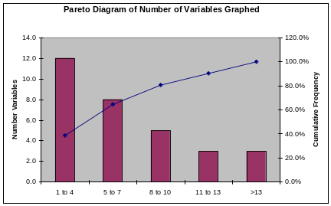
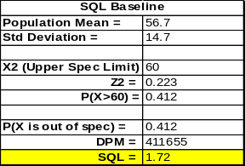
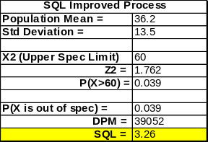
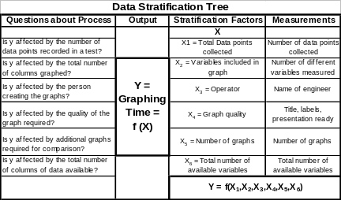
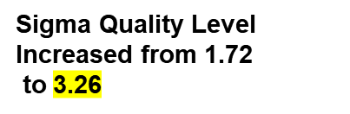
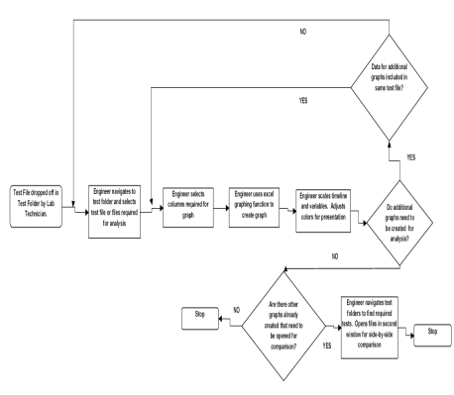
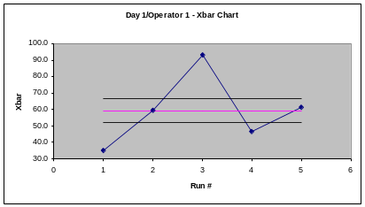
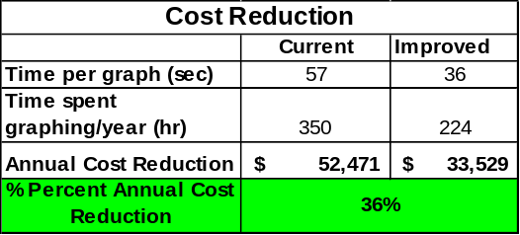

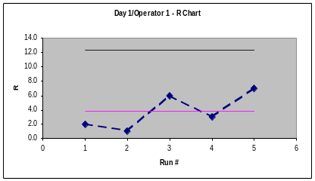
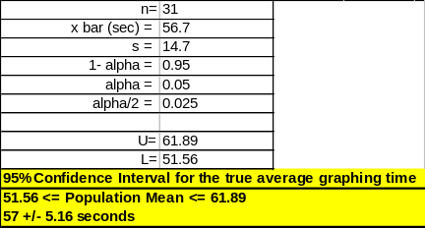
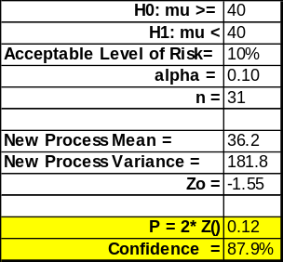
Process Improvement Project – Graphing Time Reduction
Mike – MBC 638
Key Dates --->
Team Launch
5/11/08
Define
5/19/08
Measure
5/26/08
Analyze
6/6/08
Improve
7/4/08
Control
On-Going
DEFINE
MEASURE
ANALYZE
IMPROVE
Before
After
Extensive graphing is required for good data analysis of lab qualification testing
350 Engineer hours in the department are spent on repetitive graphing procedures within Excel. This equates to $52,471/year
A 30% reduction in graphing time could result in a $15,741 annual savings.
Identified Critical Inputs and Outputs to Measure
Pareto showed that 80% of graphs consisted of 8 variables or less
Eliminated wasteful, repetitive steps that can be automated with Excel Macros
$
R Charts in control.
Xbar Charts show ability to
measure differences
PTR = 0.22
=
$18,943 annual cost reduction!
$
Control
Hypothesis test indicates 88% confidence that new process meets the goal of at least a 30% improvement in graphing time
Maintain Revision Control on original spreadsheet macros
Provide to Engineering Department
Survey engineers for usage in 3 months
95% confidence interval that true graphing time is 57 +/- 5.16 seconds
Measurement Systems Analysis using X-bar, R Charts and Precision-To-Total Ratio
BUSINESS CASE: $18,943 Annual Cost Reduction if Implemented in Engineering Department

Slide 2
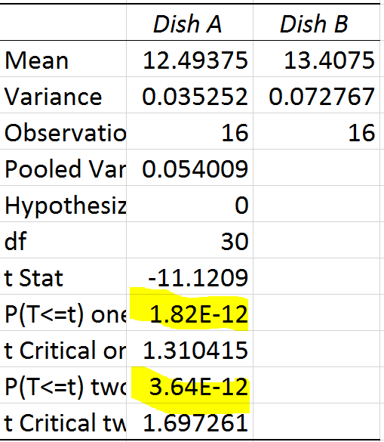
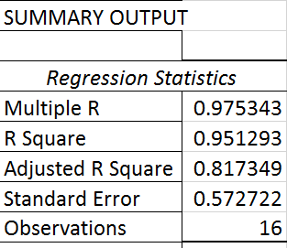
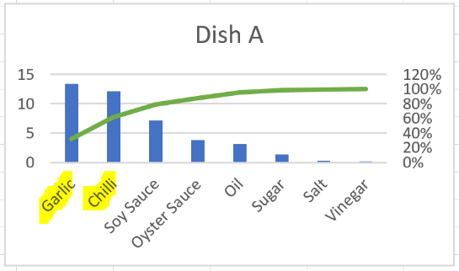
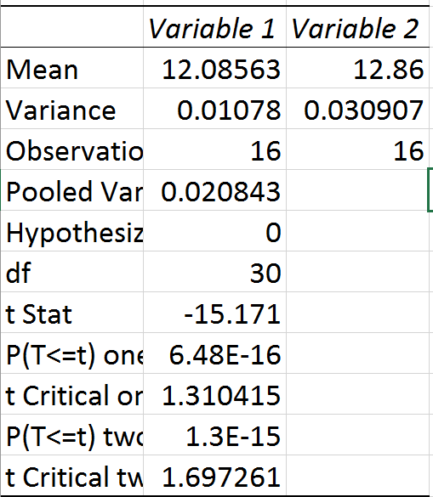
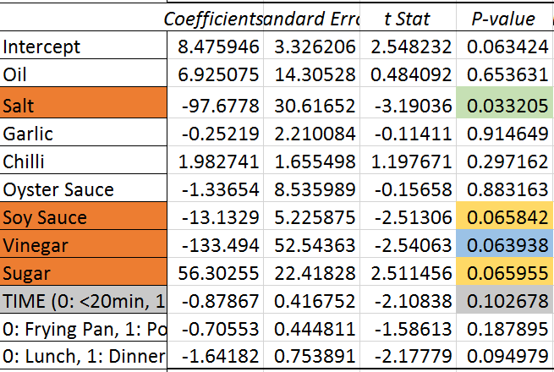
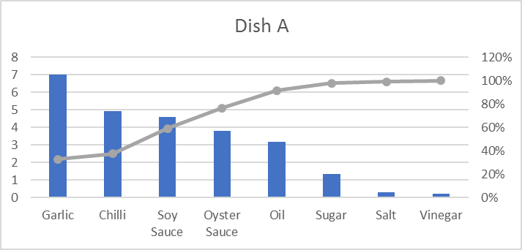
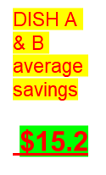
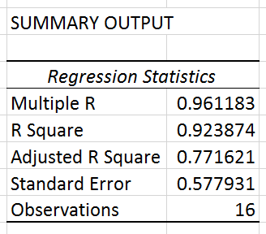
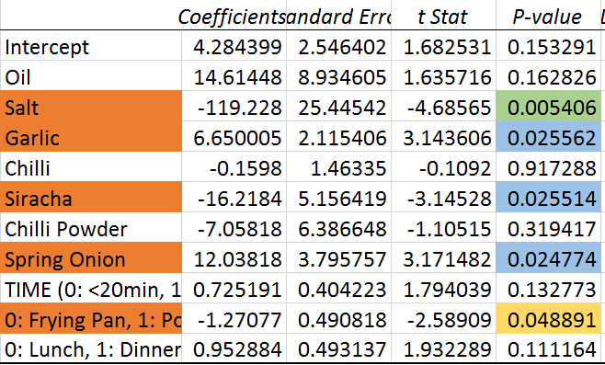
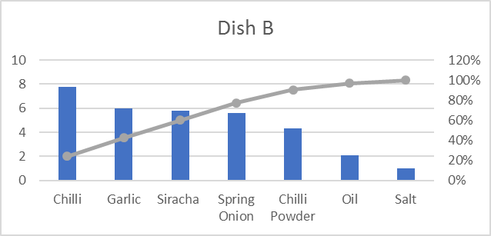
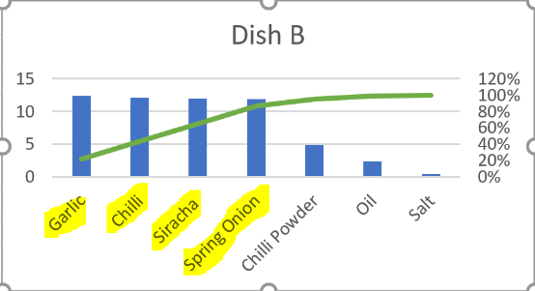
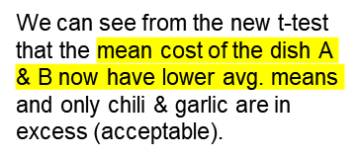
Process Improvement Project – Cooking Optimization
Process owner: Neil
Key Dates --->
Define
Feb
Measure
March
Analyze
March
Improve
April
Control
May
DEFINE
MEASURE
ANALYZE
IMPROVE
Optimize the governing factors of cooking, with considerations being the taste and cost.
2 types of dishes- A & B
A & B have a fixed amount of chicken, carrots, tomatoes, capsicum, onion.
Chilies and Garlic also, but varying quantity.
Taste of Dish A
Keeping the ingredients which have significance to cost and taste in mind, with preferences to taste; I run the test again with less quantity of salt, garlic, siracha, soy sauce, sugar and vinegar.
Dish B>Dish A, avg. means (even with less ingredients)
DISH A
S- Money (Myself) & Wegmans (Ingredients)
I- Ingredients, Utensils, Electric Stove
P-Cooking Process
O- Dish A & B
C- Volunteers
CONTROL
Taste of Dish B
DISH B
$
BUSINESS IMPACT
To save money while still maintaining taste of the dishes
When Y = cost, all ingredients are significant; but when Y = Taste above inputs are significant

Slide 3

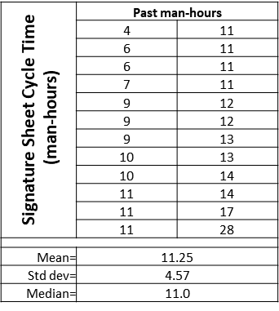
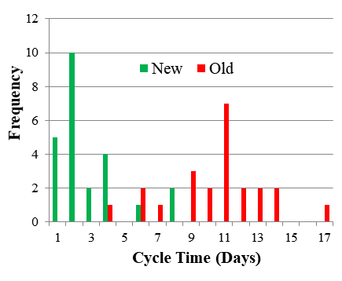
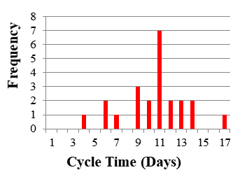


Process owner: Landon
Key Dates
Team Launch:
Define:
Measure:
Analyze:
Improve:
Control:
September 6
September 10
September 17
September 24
October 29
November 19
DEFINE
MEASURE
ANALYZE
IMPROVE
Problem Statement
Cycle time for a signature sheet averaged 11.25 days with each project manger spending about 11.25 hours for each purchase over $100,000.
SharePoint
Project manager signs form
Too many steps!
Electronic Signature Sheet
SLOW
Is project over $100,000?
R = 0.78 between no. of steps and time
No
Submit to Finance
Obtain engineering supervisor’s signature
Business Impact
The average wage a project manager earns is $35/hr, therefore it costs $393.75 per project in just gathering signatures! At 144 projects a year this process costs $56,700 annually.
Obtain production supervisor’s signature
Need to take PM out of all these steps
Cycle time reduced to 2.88 days!
Man-hours reduced to 0.20 hours!
Cost savings $55,692 annually!
SQL raised from 2.3 to 3.6 and rising!
High man-hours
High cycle time
Is it Thursday?
No
Wait for Thursday
Waste
SQL = 3.6
Obtain engineering director’s signature
P-value ≈ 0
Obtain finance supervisor’s signature
Success
CONTROL
SQL = 2.3
Obtain group director’s signature
Finance Office will not accept old version of signature sheet.
Purchases tracked in SharePoint
Appraisal rated on compliance
Hypothesis Test
H_{o}: mu ≥ 11.25 hr H_{a}: mu < 11.25 hr
Submit form to Finance Department
TEAM MEMBERS
Landon, Engineering Project Managers, Finance Office, Stakeholders

Slide 4
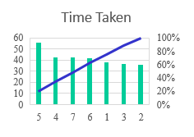
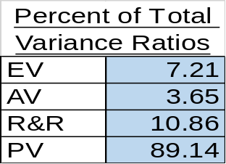
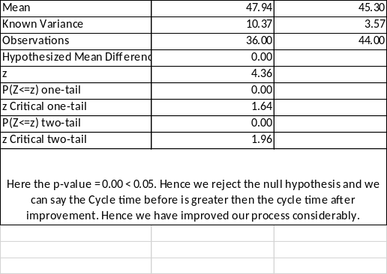
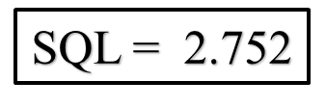


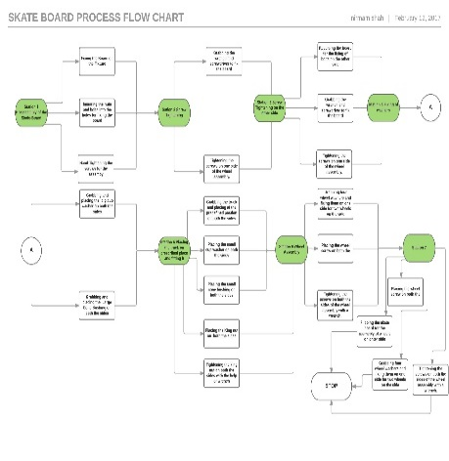


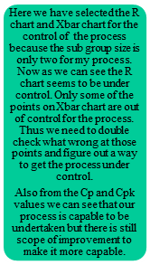

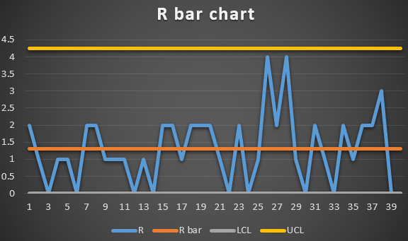
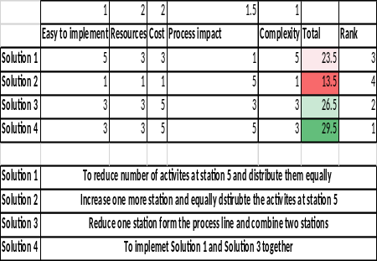
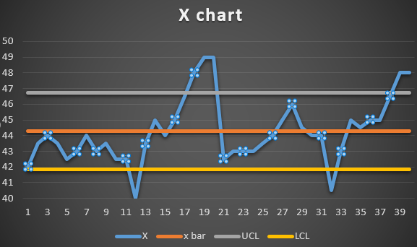


Process Improvement Project - for Widget Assembly
Nelson
Key Dates --->
Team
Launch
Define
2/02/2017
Measure
2/16/2017
Analyze
03/23/2017
Improve
04/13/2017
Control
04/20/2017
DEFINE
MEASURE
ANALYZE
IMPROVE
Problem statement: Due to high cycle times we cannot get the desired amount of throughput for the Widget assembly. The average cycle time for each part is less than 44 seconds. Defects are inherent because of improper line balancing and bottleneck in the system.
R&R =10.86% < 30 %,
Measurement plan is okay
We have finalized fourth proposed solution from the matrix and thus we need to improve the process based upon the selected solution.
Ho :Mean cycle time for part >= 44 seconds
Ha :Mean cycle time for part < 44 seconds
Sample size | 36
Sample mean | 45.036
Standard Deviation | 2.681
Hypothesized mean | 44
Test Statistic (Z) | 2.318537859
P-value | 0.989789946
From the above result P-value is greater than 0.05 thus we do not reject the Null hypothesis and thus the Mean cycle time is greater than 44 seconds. Hence we need to analyze what’s wrong
Because the Station 5 has the highest number of activities being done and thus it takes the highest time. So we need to equally divide the number of activities hence to reduce cycle time
CONTROL
> 44 seconds
Why is SQL less?
What can be done better?
What factors shall we measure, analyze and improve?
PROJECT TEAM : Nelson, Karen

Slide 5

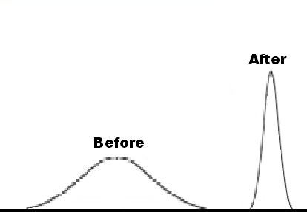
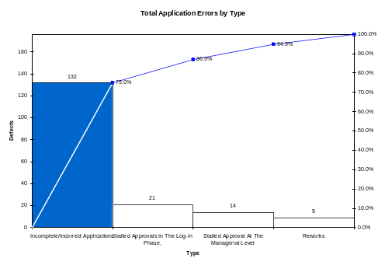
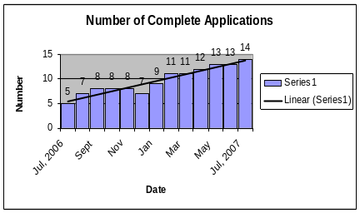

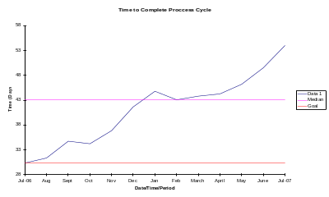
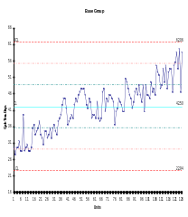
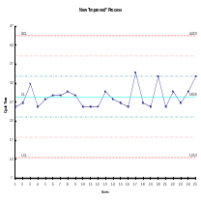


Process Improvement Project – Cycle Time Reduction
Process owner: Dan
Key Dates --->
Team Launch
8/23
Define
9/08
Measure
10/16
Analyze
10/24
Improve
10/31
Control
On-Going
DEFINE
MEASURE
ANALYZE
IMPROVE
It takes 43 days to process a grant application. Only 8% of applications are being processed within 30 days of receipt. The time to process the application has lead to unhappy applicants and staff who are finding more and more of their daily work time being devoted to “grant administration.” The funding levels available to applicants and the number of applications are expected to increase in the near future, which has the potential to compound the problem.
29 days
43 days
New Application Procedure =
Less Mistakes & Quicker Cycle Time
Problem: Incomplete and inaccurate applications were identified as the primary factor leading to defects in the process cycle.
Solution: New Application process incorporating drop down menus
SQL=3
CONTROL
The defect rate reduced from 93% to 32%
SQL=1.9
Before
After
↑ Number of Applications + ↑ Cycle Process Time __Tough Times Ahead
Monthly monitor and review procedure is in place. Out of control signal = action plan.
PROJECT TEAM: Dan • Mary • Karen • Linda • Peter
BUSINESS CASE: $54,000 in annual processing costs

Slide 6
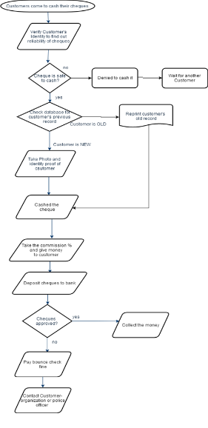
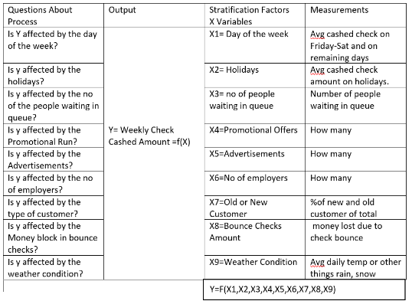
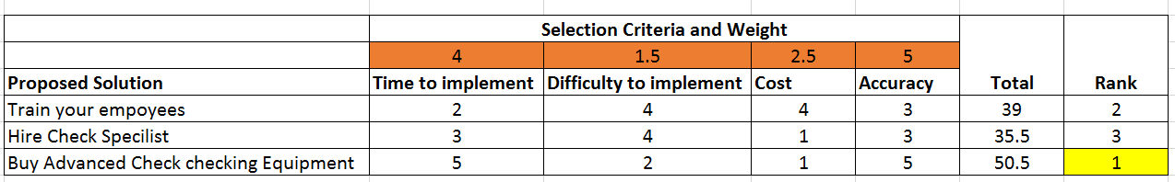
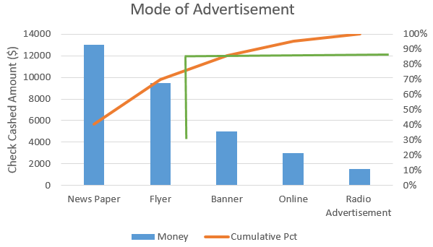
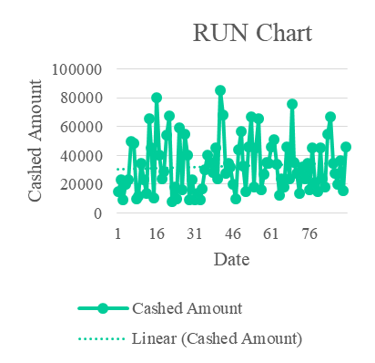
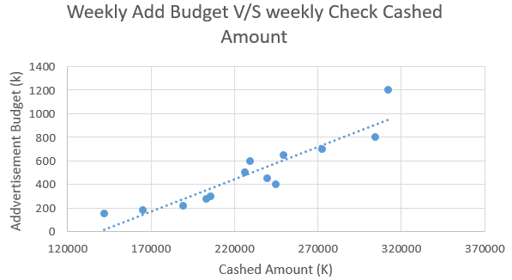
Increase Monthly Income of Check Cashing Business
Process owner: Yanni
Key Dates --->
Project Launch
2/2
Define
2/3
Measure
2/11
Analyze
3/16
Improve
4/6
Control
4/15
DEFINE
MEASURE
ANALYZE
IMPROVE
Problem Statement
Revenue varies by month. Weekly average of check Cashed amount= $80k Variability:
Cashed amount= $45-50k
Multiple Linear Regression Analysis
Advertisements
Money Lost due to Fraud Checks
Business Impact
Increase yearly cashed amount by $60K-70K by reducing the variability per month by.
That will improve monthly average income.
Weekend spikes
CONTROL
Monitor the Run chart weekly.
Implement advanced check cashing equipment and keep track of Bounced checks.
Increase newspaper and flyer advertising.
Feb
Mar

Slide 7
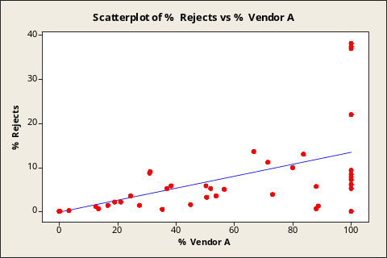
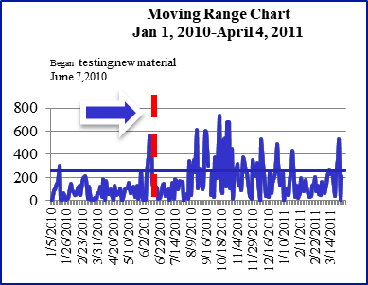
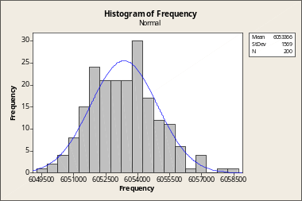








Finding the Skinny on Thin Film Sensor Reject Rates
DEFINE – 5/15/11
MEASURE - 6/1/11
ANALYZE - 7/1/11
IMPROVE - 8/1/11
7) Probable Cause 1 - Raw Material Supply
Control
1) Problem Statement:
Production reject rate of thin film sensors increases after process change.
4) Out-of-Control:
Process is highly variable to begin w/ but much worse after change.
9) Solution to Probable Cause 1
Receipt of material from Vendor A
was halted. A comparison of their measurements vs. ours found a 7.6 KHz difference!
Scatter plot reveals that using raw materials from Vendor A has a strong positive correlation of 0.7 with the reject rate.
Control Chart
Improve
Box Plot
After
DPMO of 31,934,Ouch!
Histogram
Before
Scatter Plot
The r² shows that the amount of raw material used from Vendor A explains 46.6 % of the change in reject rate.
They recalibrated their instruments & next shipment was markedly improved with a mean very close to the center of our specification range of 6.055 as shown on this histogram.
2) Work on largest category of defect for MAXIUM IMPACT
5) Change of Focus
The change did cause an increase in variability, but the process is not very good to start w/ a DPMO of 19,263! Finding the root cause of the inherent process variability should solve the new issue.
10) Solution to Probable Cause 2
I’m working with engineering to
develop a new fixture that will
improve the geometry.
Constructing a control chart of measurements taken by QC of frequency illustrates that the vendors process is out of control.
8) Probable Cause 2 – Evaporation Fixture Geometry
The sensors are held in a fixture positioned over a evaporation source that coats them with metal. I performed a test run to measure baseline performance. The data revealed that the metallic coating has too much variation in thickness w/ a mean of 2235 Å, but the range should be 500 Å. This could be caused by the position of the source, size of mask or angle of the holding fixture.
6) Identify Primary Inputs (Y)
Pareto Chart
Cause & Effect Matrix
Scoring:1=low, 3 = med, 5=high, Importance to Customer (sensors w/ correct frequency) = 1
Process Inputs (X) | Effect | Rating | Probability | Score
Vendor frequency sorting quality | Allow accurate calculation of thickness | 5 | High, makes adjustments when providing thickness data to techs | 25
Fixture Geometry | Even coating thickness | 5 | High, location determines the thickness of the coating. | 25
Separated wheat from chaff
Control – 8/8/11
3) Business Impact:
Reducing/eliminating frequency rejects will prevent reworking of part, extra inventory and labor from 100% testing which could potentially save
H_{o}: Test 1 thickness variability ≤ Test 2
10) Changes to be Made:
QC technician does acceptance testing of raw materials w/ zero tolerance.
Vendor supplies Certificate of Analysis w/ test statistics.
Control chart created for raw materials.
New fixture for more uniform thickness to prevent any frequency rejects.
Z=
=
Hypothesis Test
Z = -1.19 P = 1-Z = 1-1.19 =0.86 =86%
C&E Matrix
A second run was done to test if a centered evaporation source would decrease thickness variability (Ha). A
one-tail test was performed & the P value was high,
thus it did not significantly improve the process. This points to the mask size & fixture as the root cause of
the variation.
Rick, Steve & Production Staff

